Slide 1

Enhancement of Parkinson Disease early detection using Multi-modal data
Science, Engineering and Technology Conference
SET ID: 224221
Guide:
ANIL KUMAR K
Associate Professor Sr.
Presented By:
Nikhil Sharma (23MCS0020)
Bhavesh Kumar(23MCS0045)

Slide 2
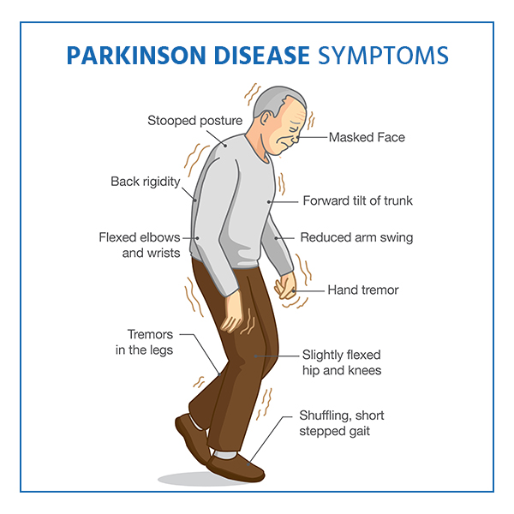
Contents :
Introduction
Literature Review
Problem Statement
Datasets
Multi-Model Analysis
Result
Model Comparison
Future Development
Conclusion
Source: https://www.parkinsonsnsw.org.au/symptoms-and-complications/

Slide 3
Introduction :
Parkinson's disease (PD) is a progressive neurological disorder that primarily affects movement. It is characterized by a loss of dopamine-producing cells.
It happens when nerve cells in the brain that produce dopamine, a chemical that helps coordinate movement, become damaged or die
Dopamine is a neurotransmitter that plays a critical role in regulating movement, so the reduction of dopamine leads to mortar and non mortar symptoms
Motor Symptoms : Tremor (hand or fingers) , Slowed movement , Rigidity(muscle pain) ,
Gait Disturbances ( Changes in walking pattern, movement )
Non-Motor Symptoms : ,Depression and Anxiety ,Cognitive Changes ,Sleep Disorders , Constipation ,Loss of Smell ,Orthostatic Hypotension ,Urinary Problems ,Fatigue

Slide 4
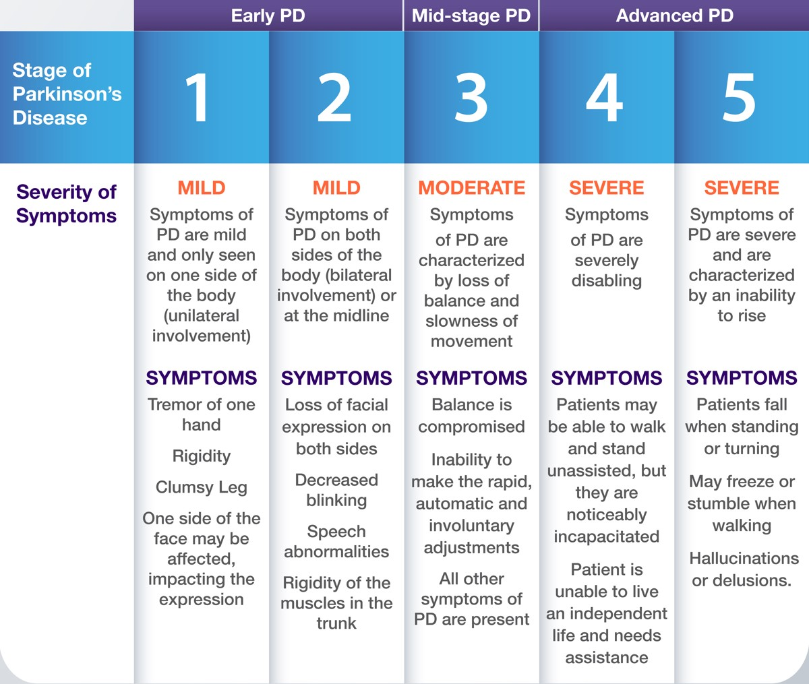

Slide 5
Literature Review :
Deep Learning-based Early Parkinson's Disease Detection from Brain MRI Image(2023)
Paper is to evaluate the performance of different deeplearn in The dataset used in the paper is MRI data from the PPMI dataset, consisting of brain scans from both Parkinson's disease patients and healthy controls.which algorithms are most effective for this task.
2,041 T1-weighted MRI datasets from 13 different studies. This included 1,024 datasets from PD patients and 1,017
Network (CNN) model achieved an accuracy of 97.3%

Slide 6
Parkinson Disease Diagnosis and Severity Rating Prediction Based on Gait analysis using Deep Learning
Paper is to evaluate the performance of different deeplearn in classifying Parkinson's Disease on normal walking, treadmill walking, and rhythmic auditory walking) using gait pattern focus on identifying which algorithms are most effective for this task.
166 participants. f93 respondents (PD) 3 healthy individuals
The paper achieved a classification accuracy of 99% for Parkinson’s Disease classification using the Convolutional Neural Network (CNN)

Slide 7
Proposed Problem Statement :
“Enhancement of PD diagnosis and early detection using Multi-modal data.”
Combine Gait analysis data features with PPMI data.
Create a end to end Multi-Modal architecture
Validate and optimize the model.
Compare with previous experiment on Gait and PPMI data.

Slide 8
Datasets :
Gait Analysis Data
Physionet Gait database contains gait analysis data of 93 individuals with Parkinson's Disease (PD) and 73 healthy control individuals.
The PD group has a mean age of 66.3 years, with 63% male patients, while the control group also has a mean age of 66.3 years, with 55% male patients.
The database records the vertical force applied to the ground by subjects as they walk in a normal fashion for nearly 2 minutes on plain ground.
Each foot has eight sensors measuring force as a function of time
Time series data is converted into a more readable format, and each sensor data is transformed into seven statistical measurements to preserve information.

Slide 9
Datasets :
Image and Clinical Data
The PPMI database stores data in a specific format requiring examination of six clinical assessments and neuro-image data for key brain areas.
Clinical assessments include MDS-UPDRS Part I, II, and III, MoCA, SCOPA-AUT, and UPSIT.
666 out of 1141 participants (58.4%) underwent all clinical and diagnostic assessments, with 28.4% diagnosed with PD, 9.3% showing no evidence of dopaminergic deficits, and 62.3% being healthy.
Clinical data collection spans 12 visits with motor assessments at three-month intervals in the first year and behavioral/cognitive assessments annually.
Imaging data, including MRI, DTI, and DAT, were conducted at various intervals, along with blood, CSF, and urine tests at scheduled intervals.

Slide 10
Experiment on Gait Dataset:
A small convolutional neural network was developed for identifying PD at an early stage using motor-based symptoms from the Physionet Gait dataset.
The neural network consists of a 1D convolutional input layer followed by additional layers including a second 1D convolutional layer, a dropout layer, another convolutional layer, another dropout layer, a fully connected dense layer, and an output layer.
The model was compiled using "Sparse Categorical Cross-Entropy" as the loss function, "RMSprop" optimizer, and a learning rate of 0.0001.
Training involved 15 epochs with a batch size of 5, achieving an accuracy of 89.61%.
The model showed a higher number of false positive cases compared to false negative cases, making it challenging to implement for critical clinical diagnosis, especially when detecting negative for individuals with PD.

Slide 11
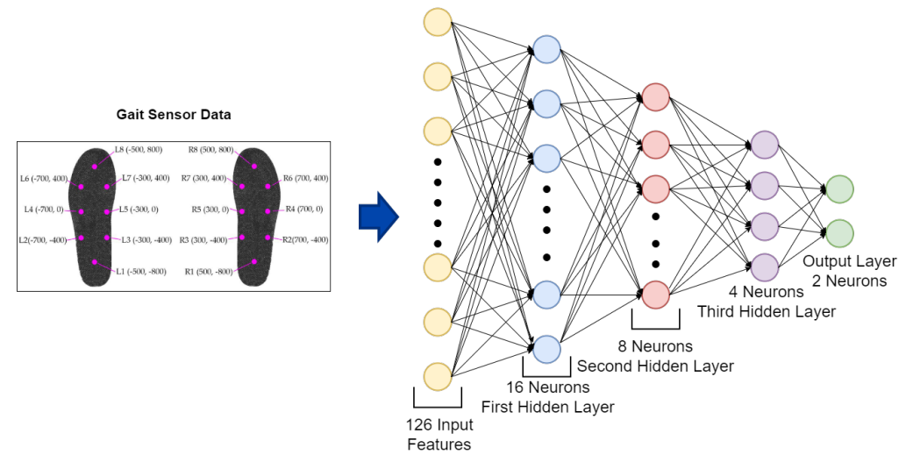
Experiment on Gait Dataset:
Gait Data Neural Network Model

Slide 12
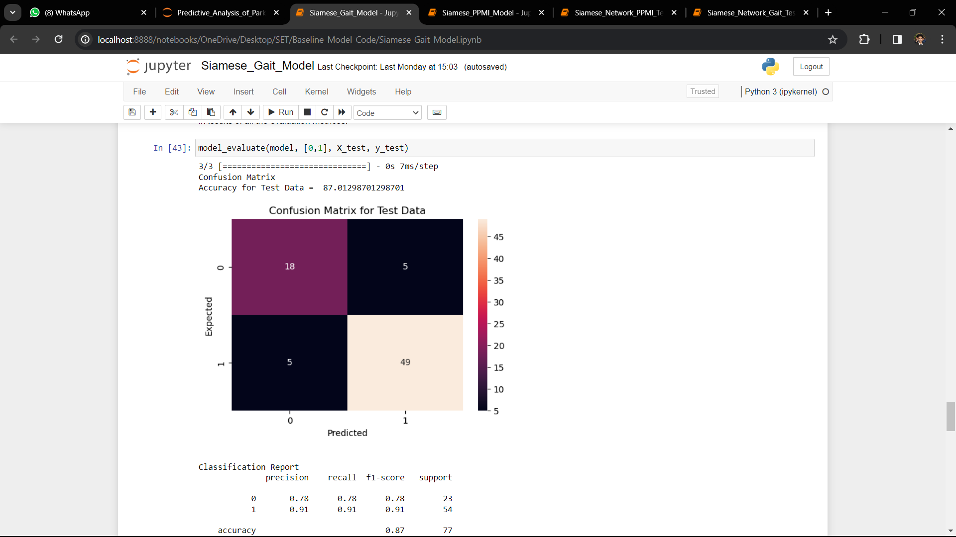

Slide 13
Experiment on PPMI Dataset:
A neural network model was developed using potential biomarkers from the PPMI dataset to classify Parkinson’s disease patients based on disease progression rate.
The model includes motor-based symptoms, neurological assessments, and non-motor-based symptom data, totaling 448 records across multiple clinical visits.
It comprises layers including 1D convolutional layers, dropout layers, and fully connected dense layers, with specific shapes and activation functions as described.
Training the model involved using "Sparse Categorical Cross-Entropy" as the loss function, "RMSprop" optimizer, and a learning rate of 0.0001, similar to the Gait model.
After 15 epochs with a batch size of 5, the model achieved an accuracy of 92.05%.

Slide 14
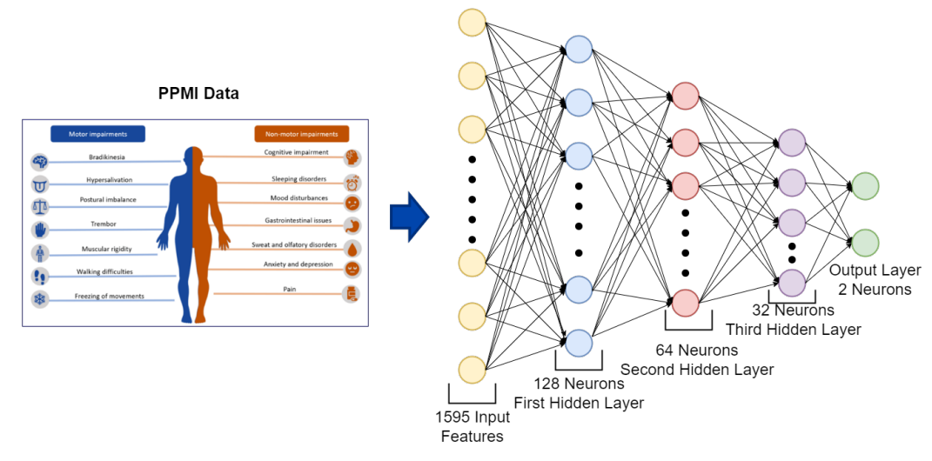
Experiment on PPMI Dataset:
PPMI Data Neural Network Model

Slide 15
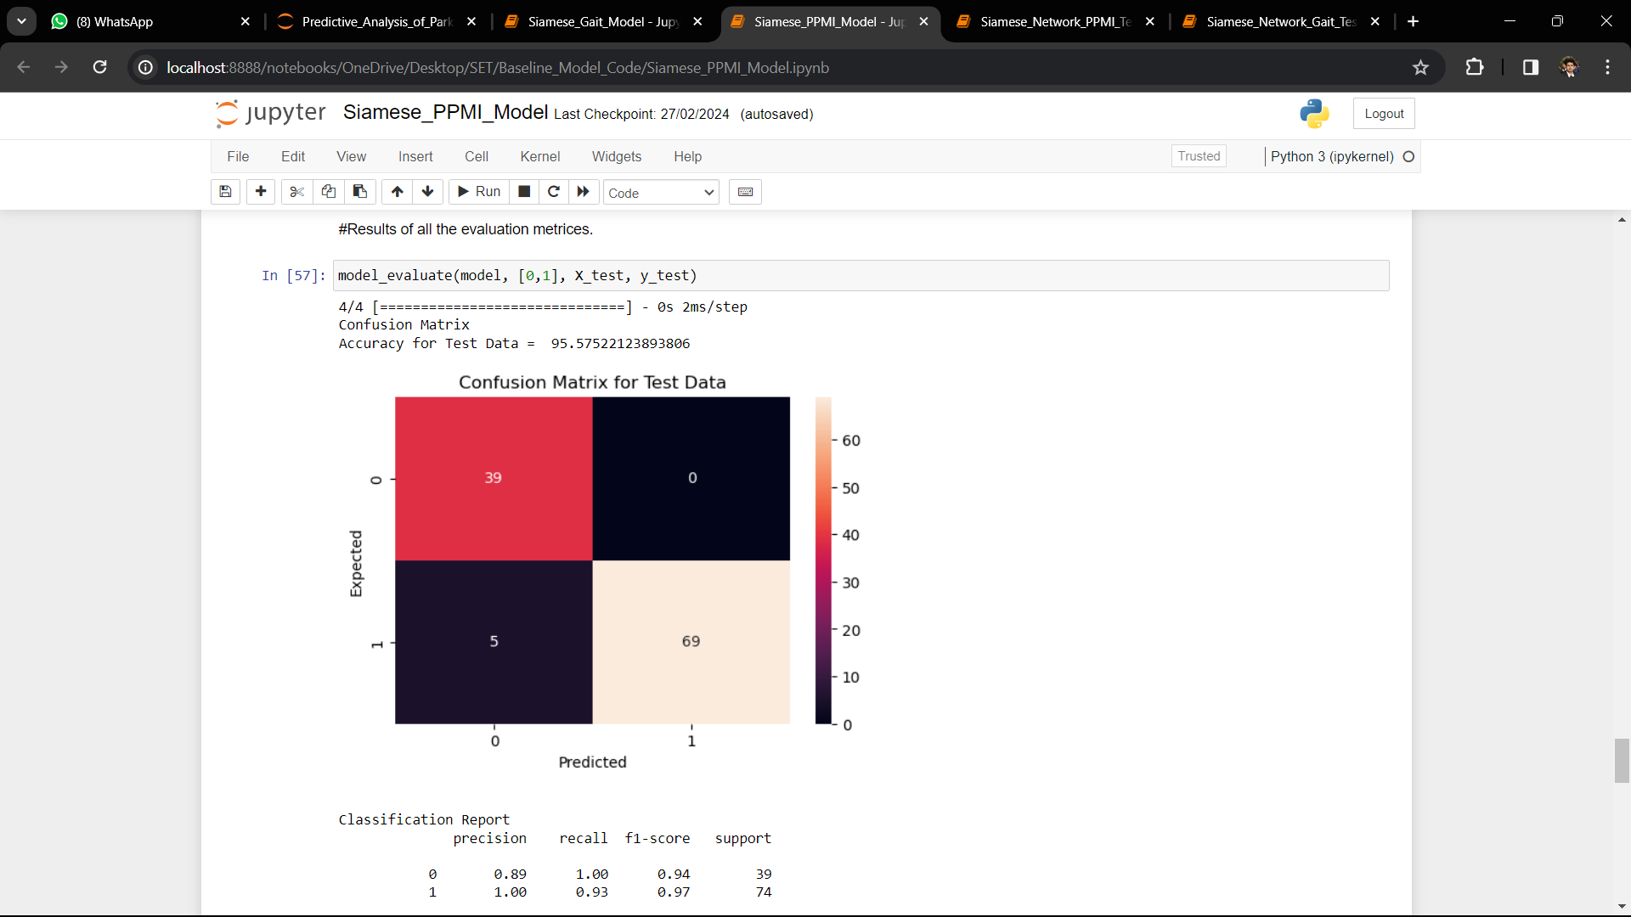

Slide 16
Multimodal Analysis :
(a) Data Generation :
Converting the Gait sensor data in more precise format to remove complexity while merging with PPMI data
Applying seven important statistical approach on each column of sensor data like Minimum, Maximum, Mean, Median, Standard Deviation, Skewness, and Kurtosis
For each subject the whole time series data boils down to 1 single row with 18x7 = 126 features (each attribute converted to 7 other columns)
For PPMI, considered 7 visits data along with baseline visit for PPMI data which gives 1597 features.

Slide 17
(a) Data Generation :
Gait data is collection of 93 PD patients and 73 HC patients whereas PPMI consist of 294 PD patients and 154 HC patient records.
Before merging, we have separated both the data based on each class distribution.
Generated combined dataset by implementing cross product between those two-dataset depending on same class.
For training 50%, with validation and testing 25% each of those datasets are used.
In total, after splitting and cross product, it produced data for training 9484, validation 2363 and for testing 2517 rows records with 1721 features.

Slide 18
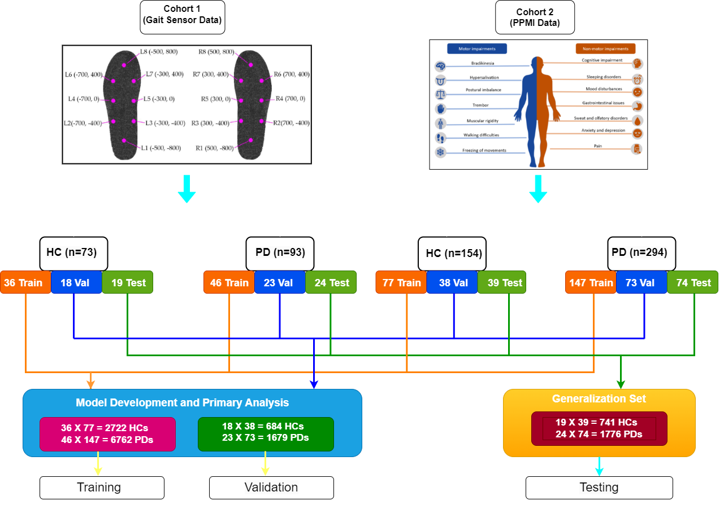

Slide 19
(b) Triplet Loss Model:
Distribute embeddings representation of data point in a manner in high dimensional vector space
Comparatively similar data points are projected in nearby space on the other hand dissimilar data points are projected far away from each other.
L = max(d(a, p)−d(a,n) +margin,0)
Calculate triplet loss which in return helps in measuring gradient in network.
There is also a hyperparameter called margin that is added to the loss function. This hyperparameter represents how far away the dissimilarities need to be. It assists us to recognize two samples much more efficiently.
Eventually we measure the gradients and these gradients helps us to update the biases and weights of the Siamese network . During training period we collect an anchor sample along with a positive and negative sample selected randomly to calculate loss and update the gradients of the network.

Slide 20
(c) Training Data Preparation:
To create triplets we need a positive sample (whose label should be same with anchor sample ), an anchor sample and a negative sample (whose label should be same with anchor sample).
Both the PPMI and Gait dataset contain two classes.
So, for each combined Gait and PPMI data (consider it as anchor sample) from train set, two samples are selected randomly from the same set where one of which is same class as the anchor sample (consider it as positive sample) and another is taken from different class (consider it as negative sample ) from training set.
Furthermore, for every batch we have selected n number of triplets.

Slide 21
(d) Multimodal Siamese Network:
As we are handling two different types of information, we have to think about combining two architectures Gait and PPMI to create a framework that can work on whole features.
To extract the features from two different networks and concatenate those features and pass it through an aggregate network where the appropriate loss function will predict its label.
Calculate difference between two embedding vector and pass it through an energy function and predict that if that pair is similar or not.
For input to Siamese network, which is basically a framework that uses input coming from more than one modality , we think of extracting second last layer of Gait and PPMI data set as a modified feature vectors for multi-modal input.

Slide 22
Those feature vectors will have the characteristic of Gait analysis and PPMI diagnostic values individually which will be concatenated before considering them as an input to Siamese network.
Gait and PPMI features will create 36 feature vectors (4 vector from Gait model and 32 from PPMI model) and consider as input to Siamese network.
Input layer with dimension of 36 features which are coming from Gait and PPMI network.
Next a dense layer with size 32 and activation function ‘Relu’.
After that there is a dropout layer with rate 0.5 and then,
Again, a dense layer with kernel size 16 with ‘Relu’ activation function.
And it ends with a dropout layer with rate 0.5 followed by a dense layer of kernel size 8 with same activation function that we have used before.

Slide 23
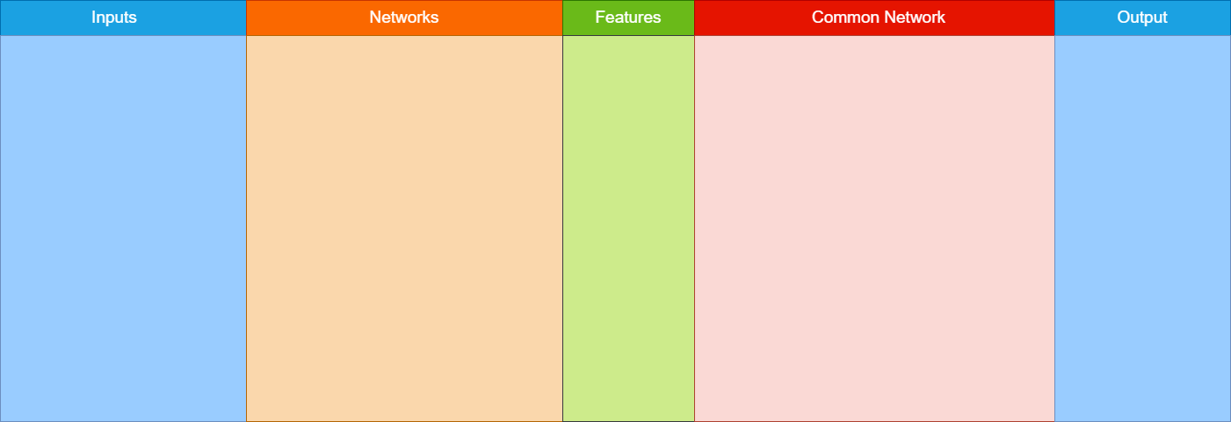
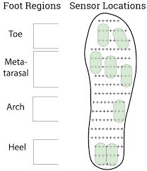
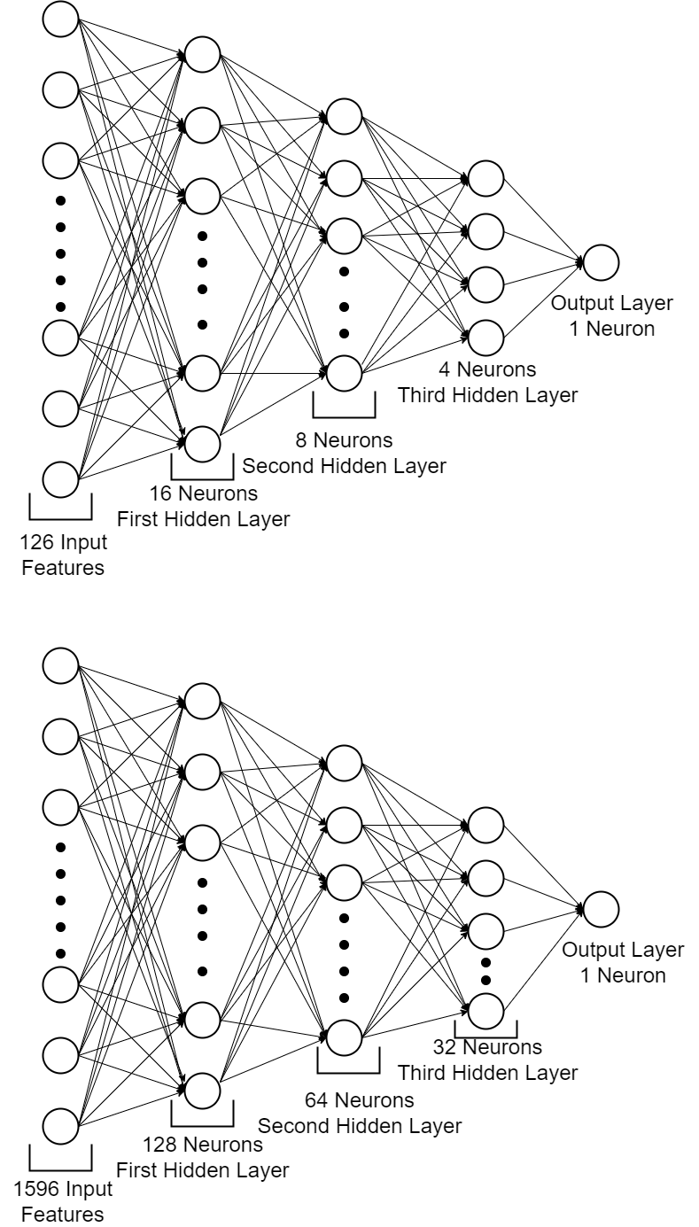
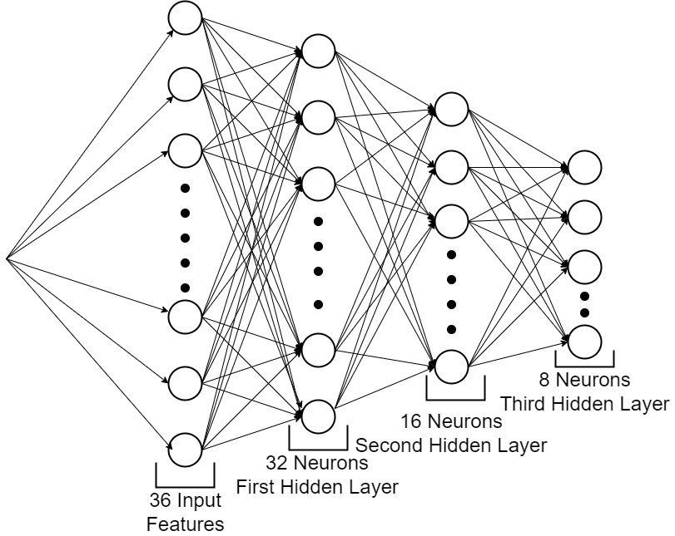
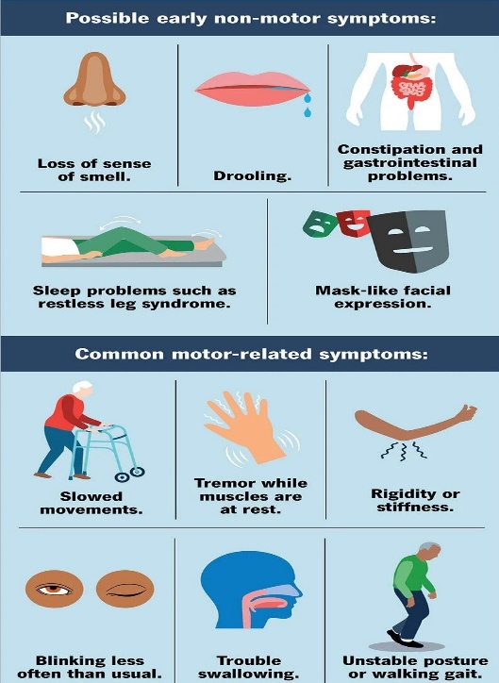
Gait Network
Siamese Network
Features Concatenation
Gait Network Features
+
PPMI Network Features
PPMI Network
Feature Vectors for Combined Data

Slide 24
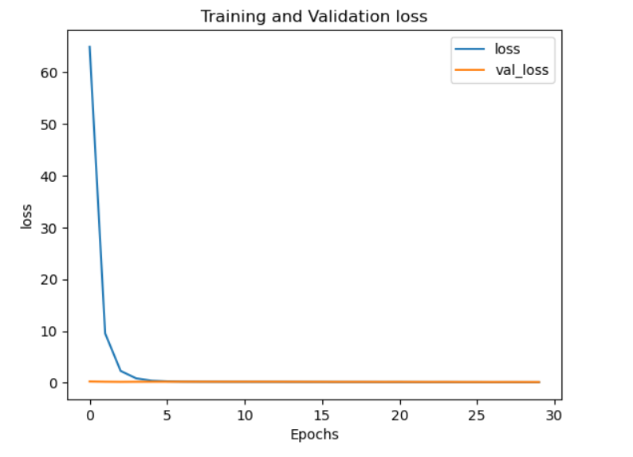
(e) Result using Triplet Loss:
Training vs validation loss graph using Triplet loss function
Similarity on combined test data.
Positive Similarity : 0.9807399
Negative Similarity : 0.93917173

Slide 25
(f) Experiment on Test Dataset:
To check our experiment in a real-world scenario we have collected all those separated Gait and PPMI data from test set without label.
Then to check model performance only for Gait data, we have randomly selected 5 positive (PD patients) and 5 negative (HC patients) PPMI data from train set and combine them individually against a single Gait test sample which will generate 10 (Gait + PPMI) samples for each gait test samples.
Now those generated data will act as anchor in triplet model along with the positive and negative samples are taken from training set of combined Parkinson’s disease patient data and Healthy Control patient data records respectively
Here the model will calculate distance similar to triplet loss model

Slide 26
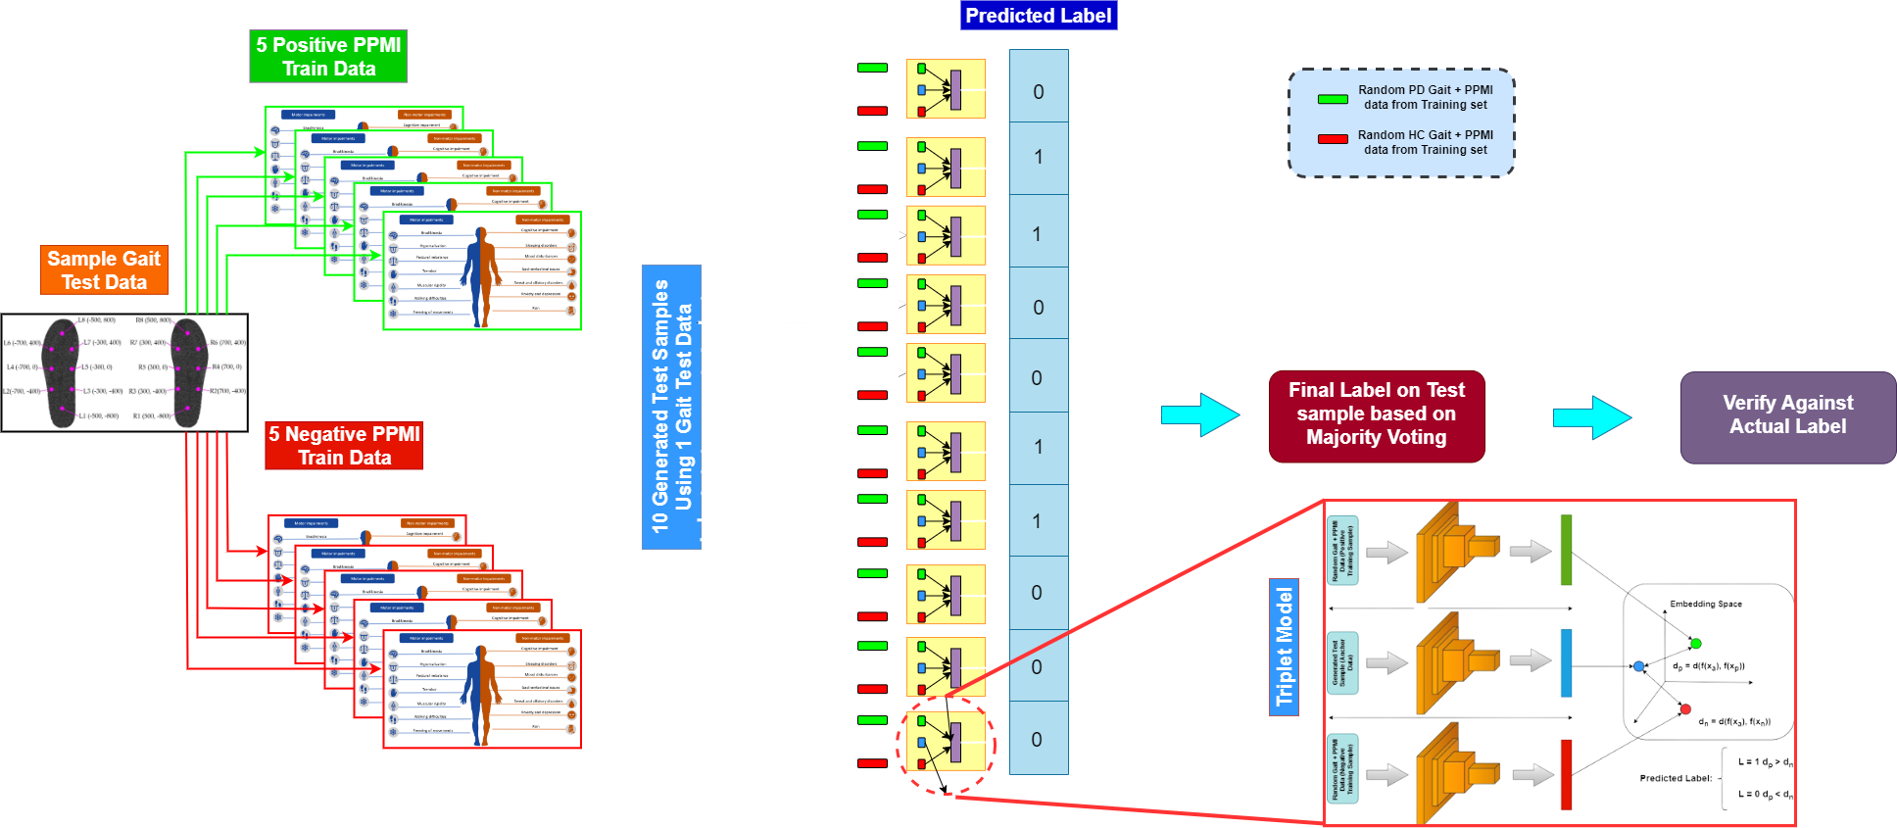
(f) Experiment on Test Dataset:

Slide 27
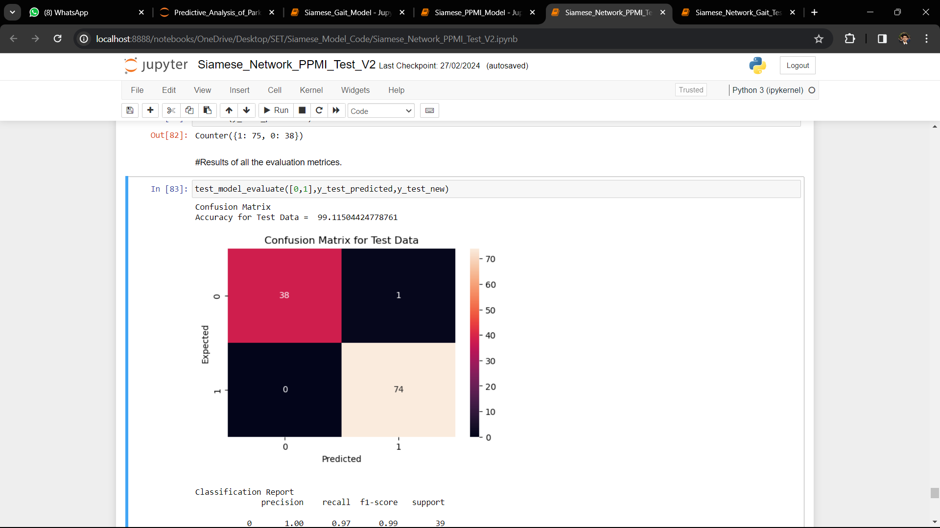

Slide 28
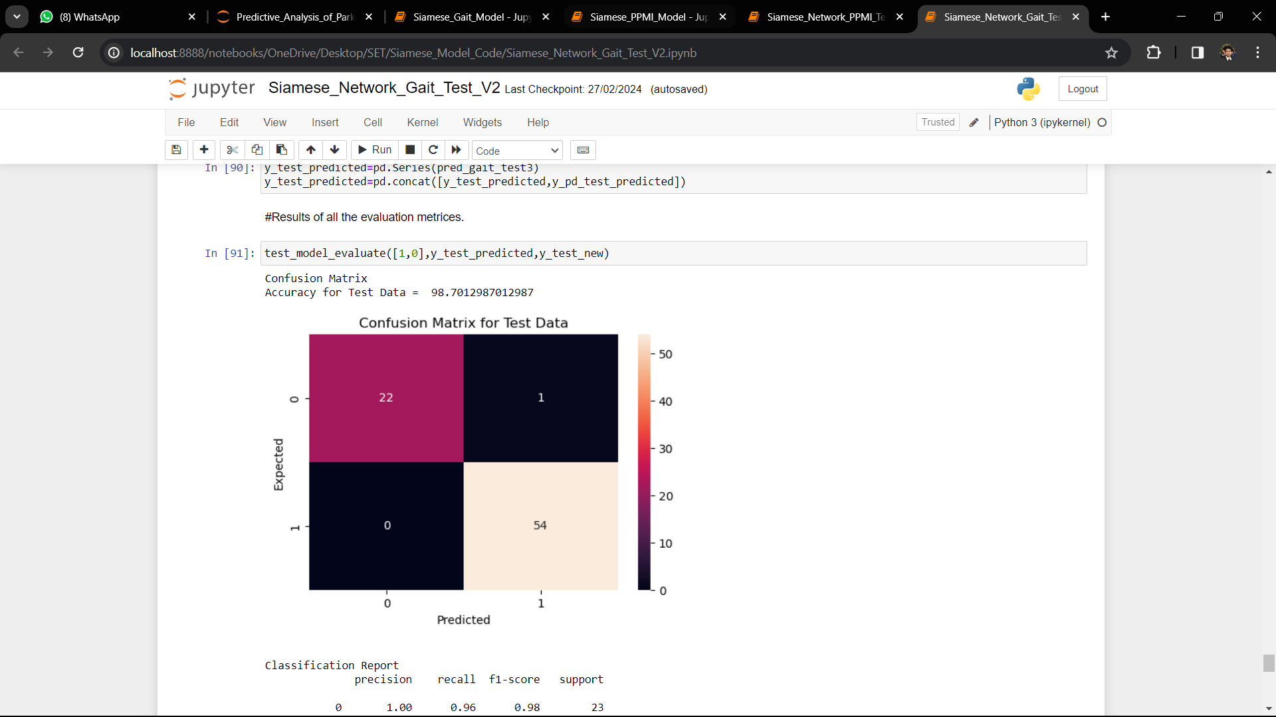

Slide 29
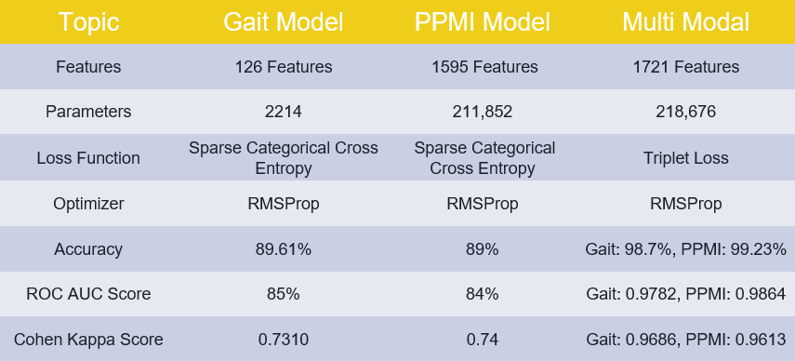
Multi-Modality vs Single Modality Comparison :

Slide 30
Future Development:
It can be extended towards classifying other serious diseases.
Adding more PPMI clinical diagnosis data.
Experiment with other fusion technique.
Better representation of Gait sensor Data.

Slide 31
Conclusion:
Experiment on Multi-Modal analysis based on Learned Feature fusion technique.
An Experiment on using features coming from different subjects.
An idea against the problem of missing modalities.
Successful in terms of reducing misclassification of data.
Achieved better AUC and sensitivity.

Slide 32
Thank You

